Slide 1

Intro to AI & Python (kick-off)

Slide 2
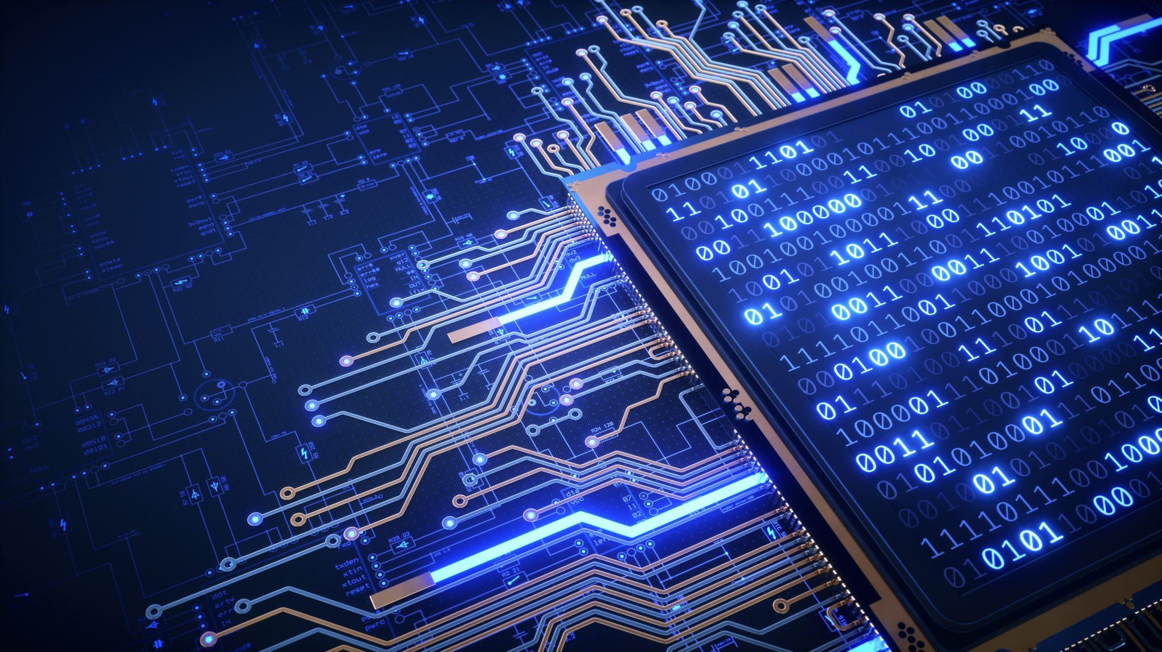
What is Artificial Intelligence (AI)

Slide 3
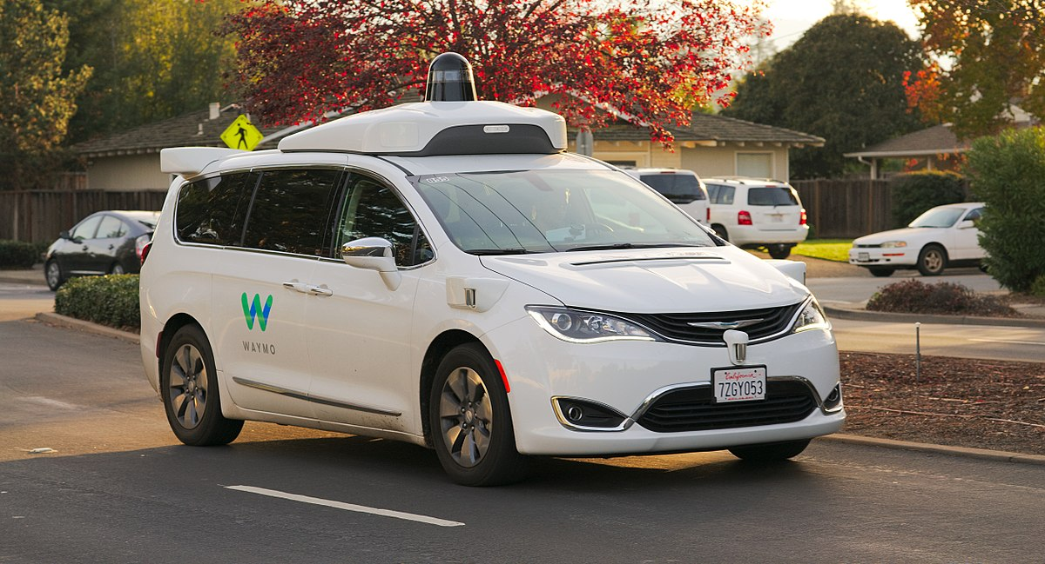
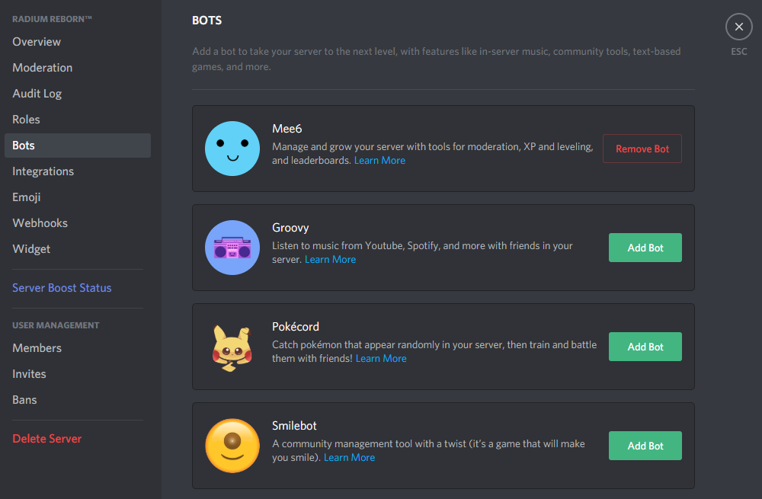
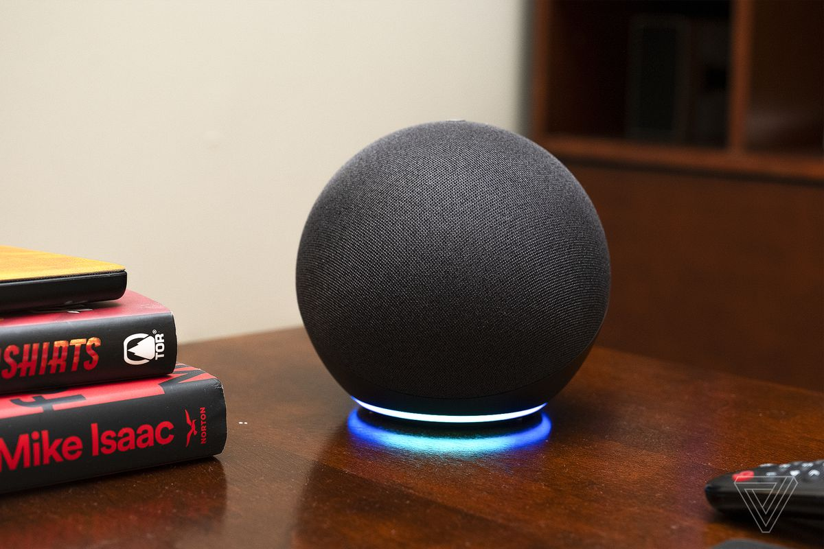
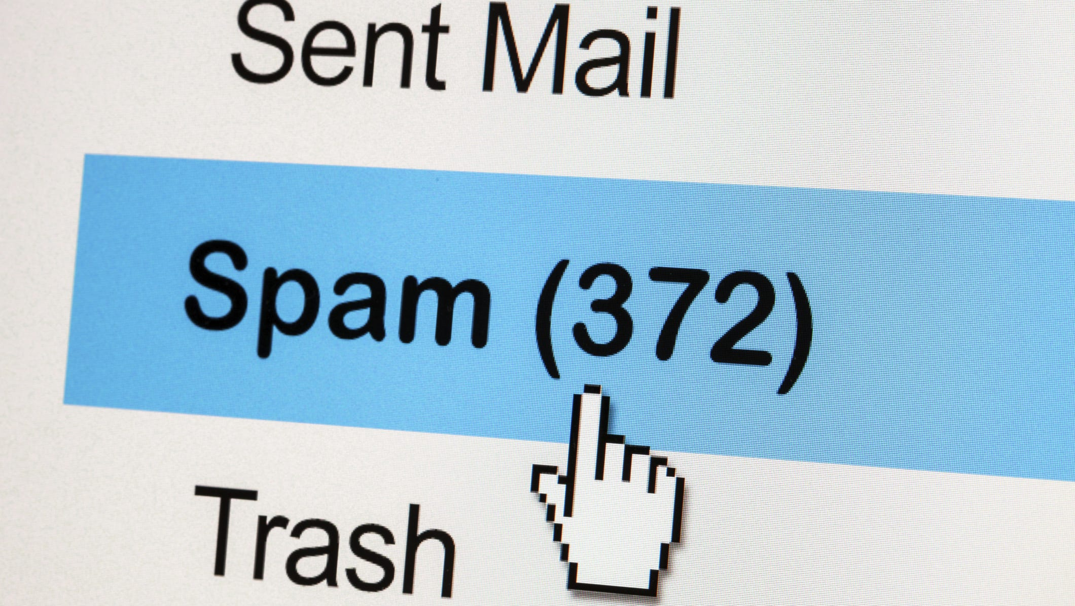
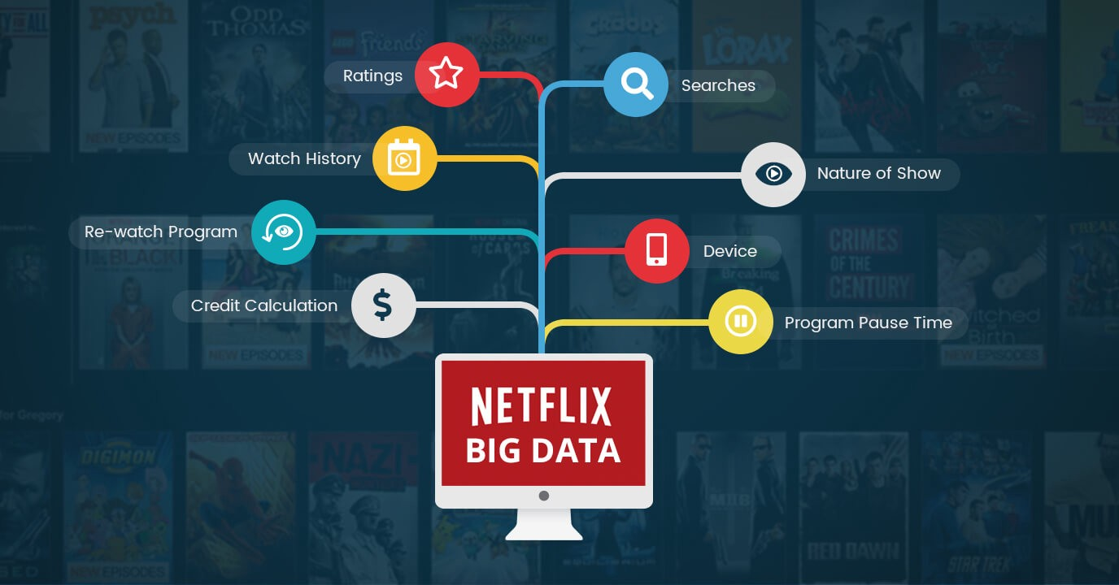
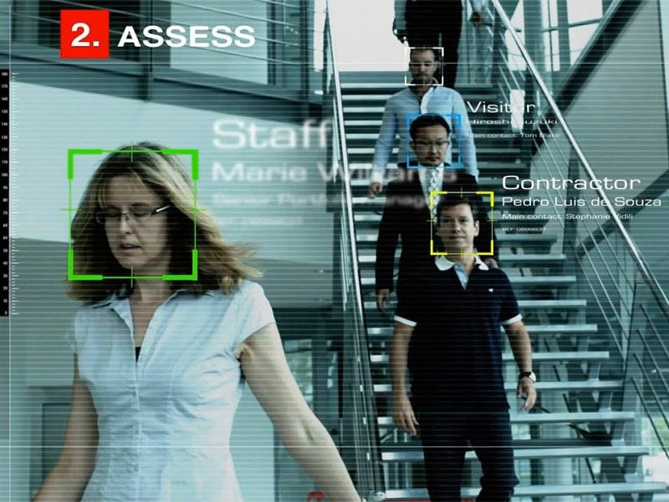
Examples of AI in everyday life
Self-driving cars
Bots
Digital Assistants
(ex: Amazon Alexa)
Email spam filters
Recommendation engines
Facial recognition
in video surveillance

Slide 4
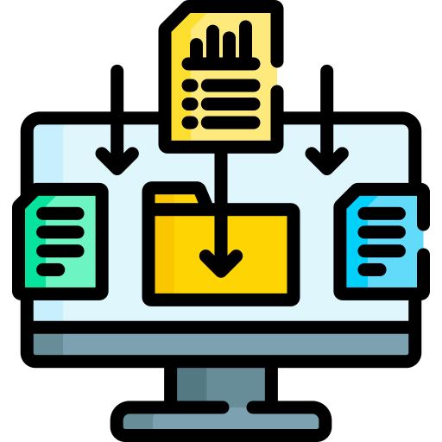
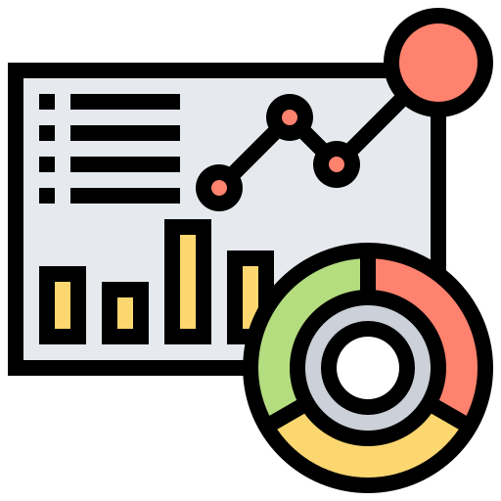
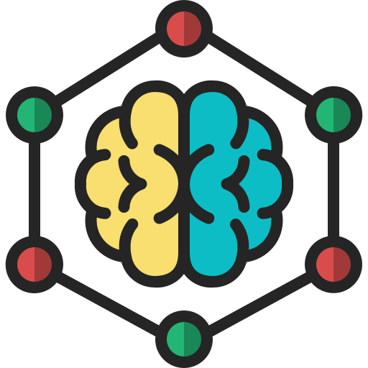
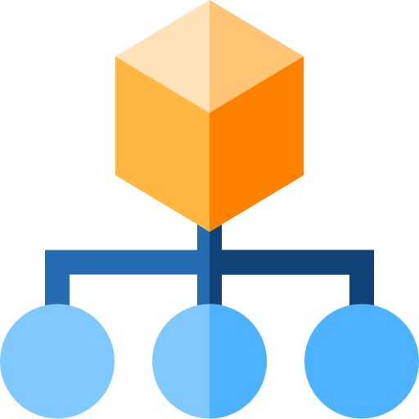
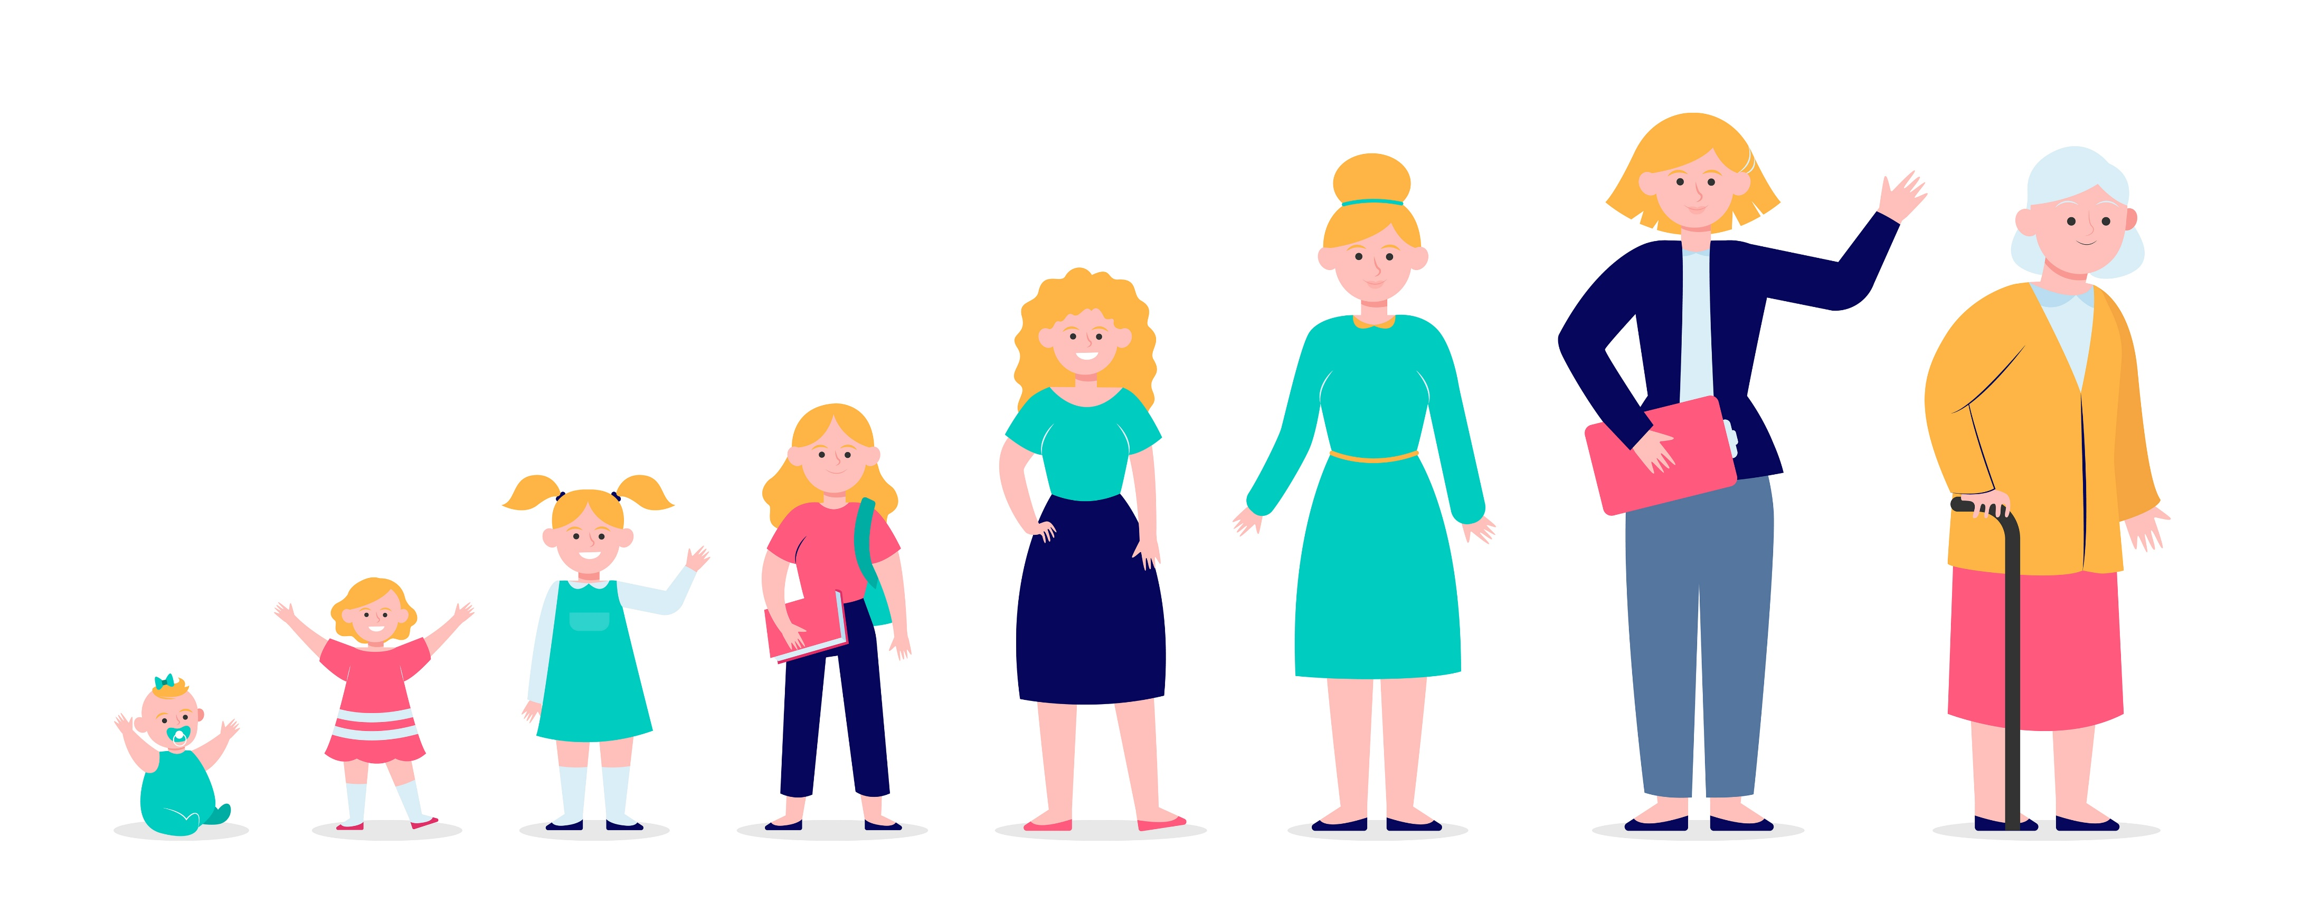
AI in simple words
Artificial Intelligence (AI) involves using computers to do things that traditionally require human intelligence.
Data gathering
Data Analysis
Algorithm
Classify

Slide 5
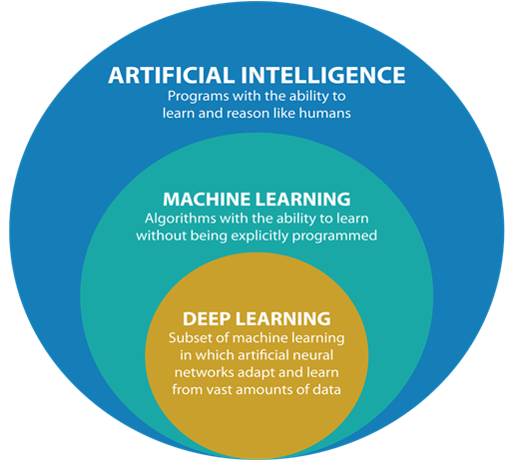
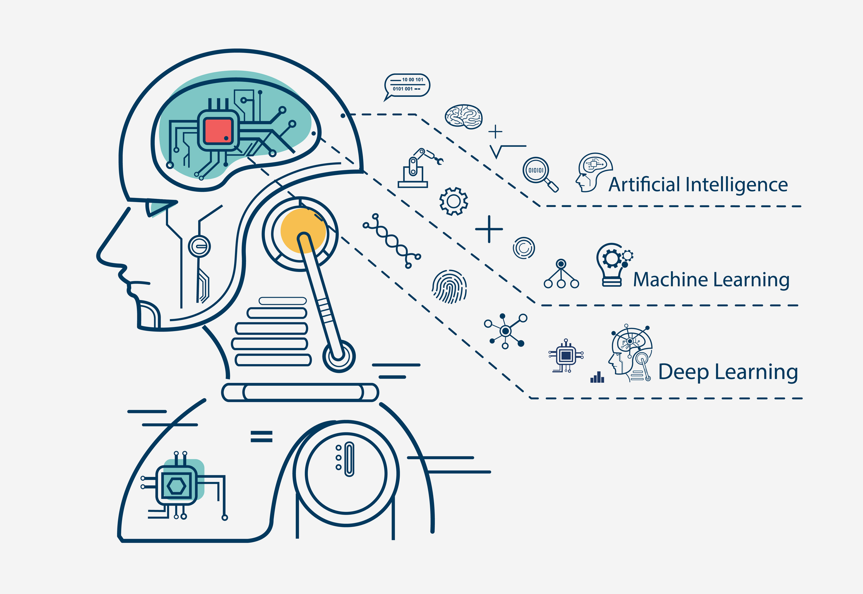
Subfields of AI
By definition…
Think of it this way…
Notes:
These are some of the keywords that you’ll encounter when developing your projects

Slide 6
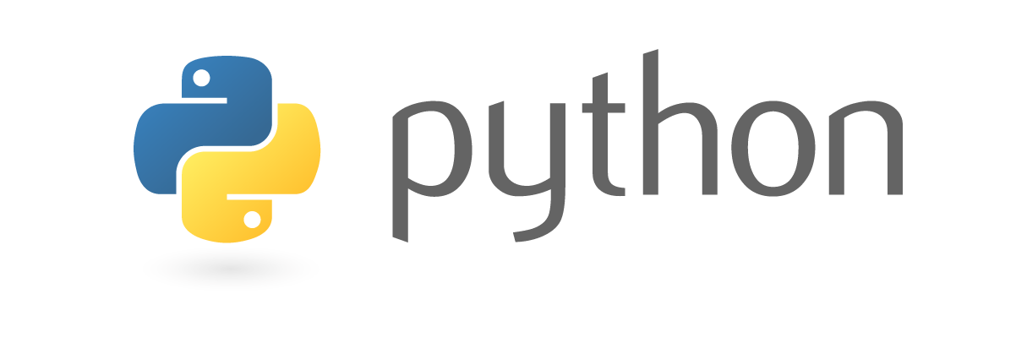

Slide 7


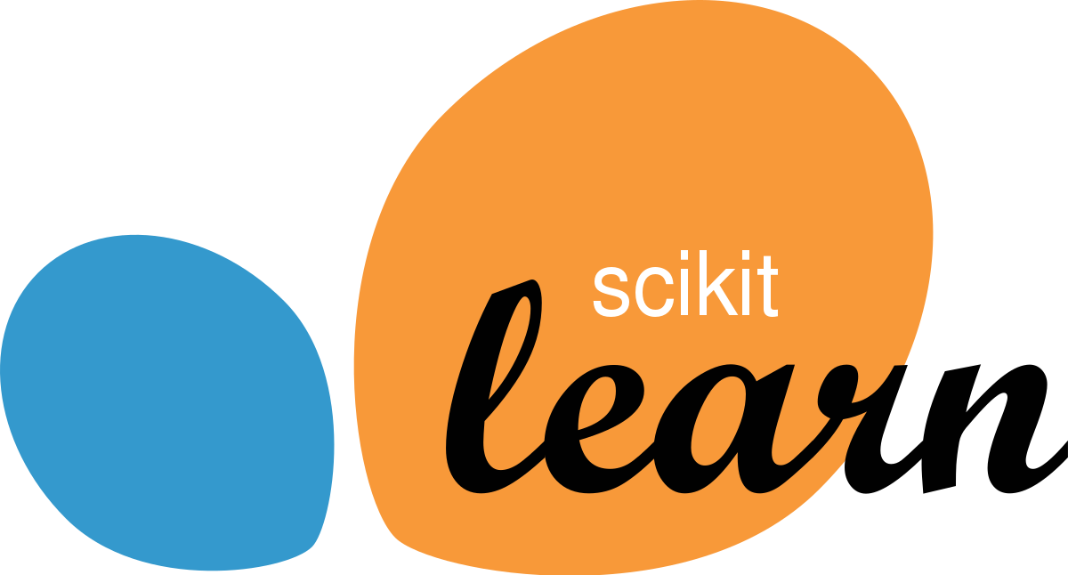




Why Python?
Most used language in machine learning
Extensive selection of libraries and frameworks
Simple and consistent

Slide 8
Python basic
Install python library
Syntax
Comments
Lists
Operators
If…Else
While Loops
For Loops
Functions
Debug technique (error, function, )

Slide 9


